Slide 1
SECTION A // HANDS-ON DEVELOPER WORKSHOP
Git & GitHub: From Zero to Your First Commit
Practical version control, command anatomy, and collaborative workflows for computer science students.
INSTRUCTOR
Sameer Ahmad Ansari

Slide 2
02 // THE MOTIVATION
The Version Control Problem
A Familiar Scenario
•
Step 1: Build working homepage layout.
~/Desktop/college-website/
•
project-final/
Step 2: Add navigation bar code.
project-final-new/
•
Step 3: CSS breaks entire page structure.
project-final-final/
•
Problem: Earlier working state is lost.
project-BROKEN-dont-touch/
Question: Is there a cleaner way to track code changes?

Slide 3
03 // DEFINITION
What Is Git?
"Git is a distributed version control system that tracks project changes and maintains a complete history of commits."
SNAPSHOT 01
SNAPSHOT 02
SNAPSHOT 03
SNAPSHOT 04
Create Homepage
Add Navbar
Fix Validation Bug
Improve Layout

Slide 4
04 // ENGINEERING VALUE
Why Developers Use Git
01 // TRACKING
02 // AUDIT
03 // ROLLBACK
Change Tracking
Commit History
Version Recovery
See exact line modifications.
Author and timestamp records.
Restore working code states.
04 // ISOLATION
05 // TEAMWORK
06 // CONFIDENCE
Branch Workflows
Team Collaboration
Safer Experiments
Build features without risk.
Combine code across developers.
Test new ideas fearlessly.

Slide 5
05 // DISTINCTION
Git vs GitHub
Git (Local Tool)
GitHub (Cloud Platform)
•
•
Core Role: Distributed version control engine.
Core Role: Hosts Git repositories online.
•
•
Execution: Runs locally on your computer.
Collaboration: Pull requests, issues, code reviews.
•
•
Internet: Works completely offline.
Internet: Requires network for syncing.
•
•
Account: Requires zero cloud registration.
Alternatives: GitLab, Bitbucket, Codeberg.

Slide 6
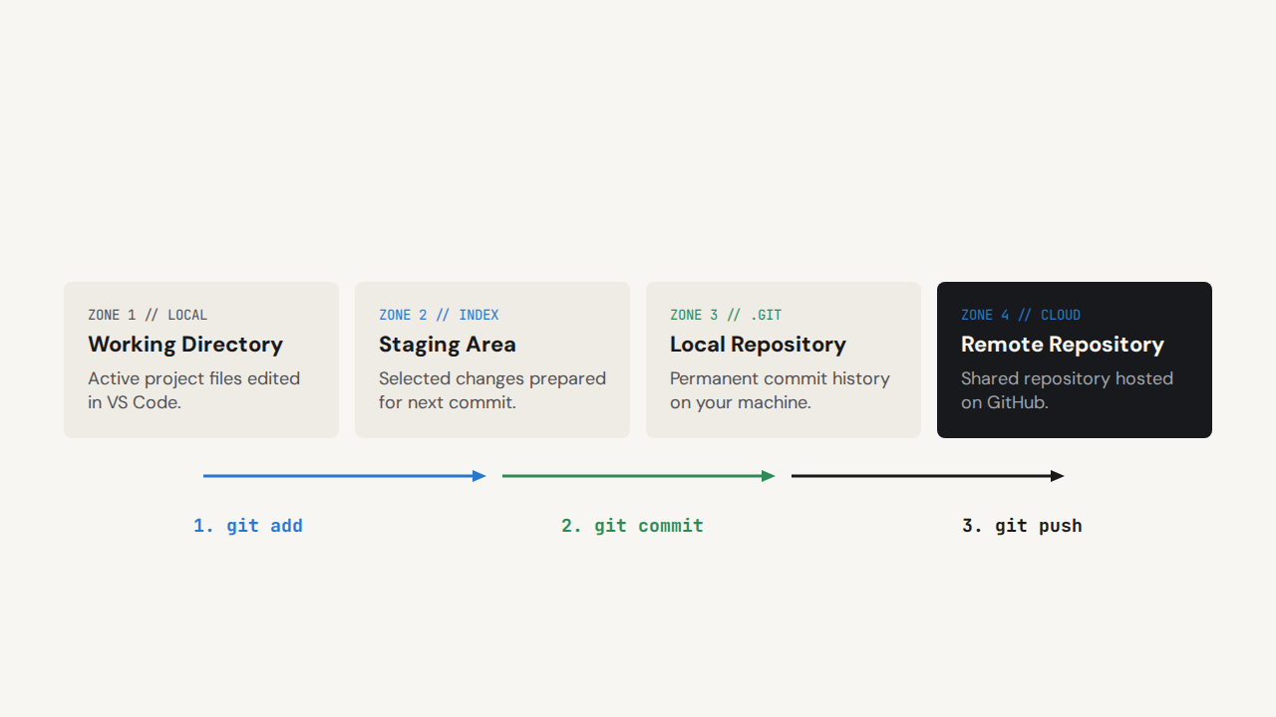
06 // ARCHITECTURE
How Git Works: Core Architecture

Slide 7
07 // TERMINOLOGY
Essential Git Vocabulary
Term | Plain-English Meaning
Repository (Repo) | Project directory tracked by Git alongside its hidden history database.
Commit | Saved snapshot of staged changes with a unique ID and message.
Staging Area | Holding zone where selected edits wait before becoming a commit.
Tracked File | File previously committed or staged that Git actively monitors.
Untracked File | New file in the folder not yet registered with Git.
Branch | Independent line of development used to isolate feature work.
Remote | External copy of your repository hosted on a server like GitHub.

Slide 8
08 // SECTION B: SETUP
Check Git Installation
•
git: Invokes the Git command-line executable.
•
--version: Option flag requesting installed software release.
$ git --version
•
Expected Output: Prints version number if installed properly.
git version 2.53.0
•
If Missing: Install from git-scm.com and restart terminal.

Slide 9
09 // IDENTITY SETUP
Configure Author Name
$ git config --global user.name "Your Name"
config
--global
user.name
"Your Name"
Subcommand that views or modifies Git settings.
Applies setting across all repositories for current user.
Configuration key storing the commit author name.
String value attached to every future commit.

Slide 10
10 // IDENTITY SETUP
Configure Author Email
•
Commit Metadata: Git embeds this email inside every commit record.
•
Not Authentication: Setting an email does not log you into GitHub.
$ git config --global user.email "your-email@example.com"
•
Privacy Tip: Public repositories expose commit emails publicly; use GitHub's noreply address if desired.
# Silent success (no output means setting saved)

Slide 11
11 // VERIFICATION
Verify Git Configuration
$ git config --global --list
user.name=Sameer Ahmad Ansari
user.email=sameer@example.com
Option / Output | Explanation
--list | Displays all active key-value pairs stored in the configuration file.
key=value | Confirms your author identity is ready before making your first commit.

Slide 12
12 // SHELL PREPARATION
Create Project Directory
$ mkdir git-practice
$ cd git-practice
•
•
Type: Terminal shell command (not Git).
Type: Terminal shell navigation command.
•
•
mkdir: Short for make directory.
cd: Short for change directory.
•
•
Result: Creates empty folder git-practice.
Result: Moves active shell inside git-practice.

Slide 13
13 // REPOSITORY CREATION
Initialize First Repository
•
init: Initializes a brand-new local Git repository.
•
Hidden .git Folder: Stores commits, branches, and configuration.
$ git init
Initialized empty Git repository in /Users/student/git-practice/.git/
•
No Automatic Commit: Creating a repository does not commit files yet.
•
Rule: Run once per project inside the project root.

Slide 14
14 // INSPECTING STATE
Check Repository Status
$ git status
On branch main
No commits yet
nothing to commit (create/copy files and use "git add" to track)
Current Branch
Untracked Files
Staged Changes
Unstaged Changes
Shows active branch timeline.
Lists new unindexed files.
Lists edits ready to commit.
Lists modified tracked files.

Slide 15
15 // SECTION C: STAGING & COMMITS
Create First HTML File
// git-practice/index.html
My Git Project
Hello, Git!
I am learning version control.
•
File Location: Saved inside git-practice/index.html.
•
Current Zone: Exists only in the Working Directory.
•
Git Status: Not staged and not committed yet.

Slide 16
16 // FILE STATES
Understanding Untracked Files
$ git status
On branch main — Untracked files:
(use "git add ..." to include in what will be committed)
index.html
•
Meaning of Untracked: Git sees index.html in the folder but ignores it until told otherwise.
•
Why Git Waits: Prevents temporary build files or secrets from entering history accidentally.

Slide 17
17 // STAGING FILES
Stage One Specific File
$ git add index.html
git
add
index.html
Calls the Git version control binary.
Copies current file contents into the staging area.
Target path selected for the upcoming commit.

Slide 18
18 // CONCEPTUAL MODEL
The Staging Area Analogy
STAGE 01 // STUDY DESK
STAGE 02 // SUBMISSION FOLDER
STAGE 03 // ARCHIVE RECORD
Working Directory
Staging Area
Commit Snapshot
All active drafts and rough work in progress.
Clean pages chosen for the next submission.
Permanent timestamped record stored in history.

Slide 19
19 // DIRECTORY STAGING
Stage Current Directory
•
The Dot (.): Represents the current working directory path.
•
Subdirectories: Recursively includes child folders underneath ..
$ git add .
# Stages all new, modified, and deleted files in "." and its subdirectories
•
Modern Git Behavior: Stages additions, modifications, and deletions in scope.
•
Best Practice: Always inspect git status before running git add ..

Slide 20
20 // REPOSITORY-WIDE STAGING
Stage All Repository Changes
$ git add -A # -A (--all) stages changes across the entire repository
Command | Path Scope
git add index.html | Stages only one specific named file.
git add . | Stages eligible changes inside current directory and child folders.
git add -A | Stages all changes across entire repository regardless of current subfolder.

Slide 21
21 // INSPECTING DIFFS
Inspect Unstaged Changes
•
What Diff Means: Line-by-line difference between file versions.
$ git diff
•
Minus (-): Original line removed or replaced.
@@ -7,3 +7,3 @@
•
Plus (+): New line added in working directory.
- Hello, Git!
+ Welcome to Git Workshop
•
Important Rule: Plain git diff shows only unstaged edits.

Slide 22
22 // PRE-COMMIT REVIEW
Inspect Staged Changes
•
--staged Flag: Tells Git to inspect the staging area snapshot.
$ git diff --staged
•
Quality Check: Lets you verify exact lines before creating a commit.
+ Hello, Git!
•
Key Contrast: git diff checks unstaged edits; git diff --staged checks staged edits.
Compares Staging Area against the last commit.

Slide 23
23 // RECORDING HISTORY
Create Your First Commit
$ git commit -m "Create homepage"
[main (root-commit) a1b2c3d] Create homepage — 1 file changed, 11 insertions(+)
git
commit
-m
"Create homepage"
Core CLI program.
Records staged snapshot locally.
Inline commit message flag.
Descriptive summary in quotes.

Slide 24
24 // COMMIT MESSAGES
Writing Clear Commit Messages
Why Supply -m?
Good Messages (Specific)
•
With -m: Passes message directly on the command line.
•
Add homepage navigation: Clear action.
•
Fix login validation: Clear bugfix.
•
Without -m: Opens default terminal text editor (often Vim) to type a message.
•
Update page styling: Clear scope.
Avoid vague messages: "Changes", "Final", "asdf"

Slide 25
25 // AUDIT LOG
View Full Commit History
•
Commit ID (SHA): Unique 40-character cryptographic fingerprint.
$ git log
commit a1b2c3d4e5f678901234567890abcdef12345678 (HEAD -> main)
•
Author: Name and email from git config.
Author: Sameer Ahmad Ansari
•
Date: Exact timestamp when commit was recorded.
Date: Tue Oct 27 10:15:00 2026 +0530
•
Message: Summary passed via -m.
Create homepage

Slide 26
26 // COMPACT LOG
Compact Commit History
$ git log --oneline
f9d8e7c (HEAD -> main) Update homepage heading
a1b2c3d Create homepage
•
--oneline Flag: Condenses each commit onto a single readable line.
•
Short Hash: Displays first 7 characters of the commit ID for quick reference.
•
Ideal Use Case: Quickly scanning dozens of commits on a classroom screen.

Slide 27
27 // CORE MENTAL MODEL
Staging vs Committing
"Add selects changes. Commit records the selected changes."
$ git add index.html
$ git commit -m "Update homepage"
Prepares specific edits in the staging area without creating a commit.
Takes only what is currently staged and saves a permanent snapshot.

Slide 28
28 // SHORTCUT & LIMITATIONS
The Commit -a Shortcut
Case 1 (Tracked File Modified): git commit -a -m "Update homepage" stages and commits index.html.
Case 2 (New File about.html): Ignored by -a! Run git add about.html first.
Command | Purpose
git add . | Stage eligible changes within the current directory scope
git add -A | Stage all relevant repository changes
git commit -m "Message" | Commit staged changes
git commit -a -m "Message" | Automatically stage tracked modifications/deletions and commit them

Slide 29
29 // SECTION D: INSPECT & UNDO
Inspect Commit Details
•
git show: Displays metadata and exact diff of the latest commit.
$ git show
•
Placeholder: Replace angle brackets with a real commit hash like a1b2c3d.
commit f9d8e7c (HEAD -> main)
+ Welcome to Git Workshop
•
Read-Only: Safely inspects history without altering files.
$ git show a1b2c3d

Slide 30
30 // UNSTAGING
Unstage Changes Safely
$ git restore --staged index.html
Before Command
After Command
Changes to be committed: modified: index.html
Changes not staged for commit: modified: index.html
File is sitting inside the Staging Area.
Moved back to Working Directory; edits preserved.

Slide 31
31 // DESTRUCTIVE OPERATION
Discard Uncommitted Edits
Permanent Data Loss Warning
•
Effect: Overwrites working file with last committed version.
$ git diff
+ Temporary test line
•
Irreversible: Discarded unstaged edits cannot be recovered.
$ git restore index.html
•
Safety Habit: Always inspect git diff before running git restore.

Slide 32
32 // UNDOING COMMITS
Safely Revert a Commit
$ git revert HEAD
[main c4d5e6f] Revert "Update homepage heading"
HEAD Pointer
New Inverse Commit
Preserves History
Revert vs Restore
Refers to your currently checked-out commit.
Records a new commit that reverses prior changes.
Does not delete the original commit from log.
Revert undoes commits; restore undoes uncommitted edits.

Slide 33
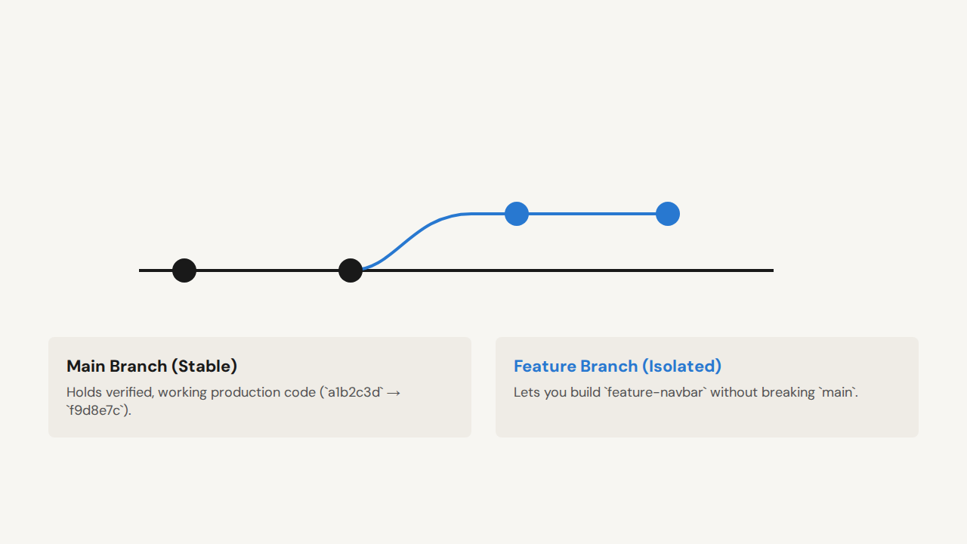
33 // SECTION E: BRANCHING
What Is a Git Branch?

Slide 34
34 // INSPECTING BRANCHES
List Local Branches
•
git branch: Lists all branches stored in your local repository.
$ git branch
•
Asterisk (*): Indicates the currently active branch (`HEAD`).
* main
•
Where Commits Go: Any new commit is added to the starred branch.

Slide 35
35 // CREATING BRANCHES
Create and Switch Branch
$ git switch -c feature-navbar
Switched to a new branch 'feature-navbar'
switch
-c
feature-navbar
Modern command for changing active branches.
Creates the new branch before switching to it.
Descriptive name for the isolated feature branch.

Slide 36
36 // SWITCHING CONTEXT
Switch Back to Main
•
No -c Flag: Omit -c because main already exists.
•
Working Directory Updates: Files in VS Code immediately reflect main snapshot.
$ git switch main
Switched to branch 'main'
•
Why Return to Main: Prepare to merge finished feature work or start another branch.

Slide 37
37 // INTEGRATING WORK
Merge Feature Into Main
$ git switch main
$ git merge feature-navbar
Updating f9d8e7c..b7c8d9e — Fast-forward (index.html | 4 ++++)
1. Target Branch First
2. Run git merge
3. Fast-Forward
Switch to main before merging.
Pass source branch feature-navbar.
main incorporates navbar commit.

Slide 38
38 // SECTION F: GITHUB & REMOTES
Create Remote on GitHub
1.
Sign In: Log into your account at github.com.
2.
New Repository: Click the + icon in the top-right corner and select New repository.
3.
Repository Name: Enter git-practice to match your local folder.
4.
Visibility: Choose Public or Private.
5.
Create Empty Remote: Leave README, .gitignore, and license unchecked.
Why Empty? Creating an empty remote prevents unrelated-history conflicts when pushing an existing local repo.

Slide 39
39 // LINKING REMOTE
Connect Remote Repository
$ git remote add origin https://github.com/username/git-practice.git
remote
add
origin
Manages external hosted repository links.
Registers a new remote connection bookmark.
Conventional alias name for primary remote.
HTTPS or SSH address copied from GitHub.

Slide 40
40 // REMOTE VERIFICATION
Verify Remote URLs
•
-v (--verbose): Displays both alias names and full destination URLs.
$ git remote -v
origin https://github.com/username/git-practice.git (fetch)
•
(fetch) URL: Endpoint used when downloading updates from GitHub.
origin https://github.com/username/git-practice.git (push)
•
(push) URL: Endpoint used when uploading local commits to GitHub.

Slide 41
41 // BRANCH NAMING
Standardize Main Branch Name
$ git branch -M main
branch
-M
main
Manages local branch pointers.
Force-renames (`--move --force`) current branch.
Modern default branch name expected by GitHub.

Slide 42
42 // PUBLISHING COMMITS
Push Commits to GitHub
•
push: Uploads local branch commits to the remote repository.
•
-u (--set-upstream): Links local main to origin/main so future pushes only need git push.
$ git push -u origin main
Enumerating objects: 9, done.
•
origin main: Pushes to remote origin on branch main.
* [new branch] main -> main
branch 'main' set up to track 'origin/main'.
•
Result: Refresh GitHub in browser to see index.html!

Slide 43
43 // DOWNLOADING REPOSITORIES
Clone Existing Repository
$ git clone https://github.com/username/git-practice.git
Cloning into 'git-practice'... done.
•
Creates Folder: Automatically creates the project folder and downloads all files.
•
Full History: Copies the entire `.git` commit history and branches.
•
Auto-Configures Origin: Sets up `origin` remote automatically (no `git init` or `git remote add` needed).

Slide 44
44 // SYNCING UPDATES
Remote Sync: Fetch vs Pull
$ git fetch
$ git pull
•
•
Action: Downloads new remote commits quietly.
Action: Fetches remote updates AND integrates them immediately.
•
Working Files: Does NOT modify your open project files.
•
Working Files: Updates your checked-out branch and files.
•
Use Case: Safely inspect teammate changes before merging.
•
Formula: Equivalent to running git fetch + integrate.

Slide 45
45 // SECTION G: WRAP-UP & LIVE CHALLENGE
Complete Workshop Workflow
mkdir/cd → git init → Edit File → git status → git add → git diff --staged → git commit -m → git log --oneline → git remote add → git push -u origin main
Hands-On Student Challenge
"Create a repository, make two commits, create a feature branch, add a navbar, and publish the project to GitHub."
Questions & Live Debugging — Instructor: Sameer Ahmad Ansari

